Slide 1
E-COMMERCE PLATFORM DATABASE
Presented by : Group no. 5

Slide 2
Introduction
TEAM
MANASI GHODAKE - H22010
RIDDHI RAJU CHOPDEKAR - H22020
PRATIKSHA GOPAL BHAWAR – H22013
AJINKYA
Scope
Supplier to customer one way shipping process including product details and financial details of both supplier and customer.
Customer reviews Wishlist and cart data stored where an actual order may or may not have been placed

Slide 3
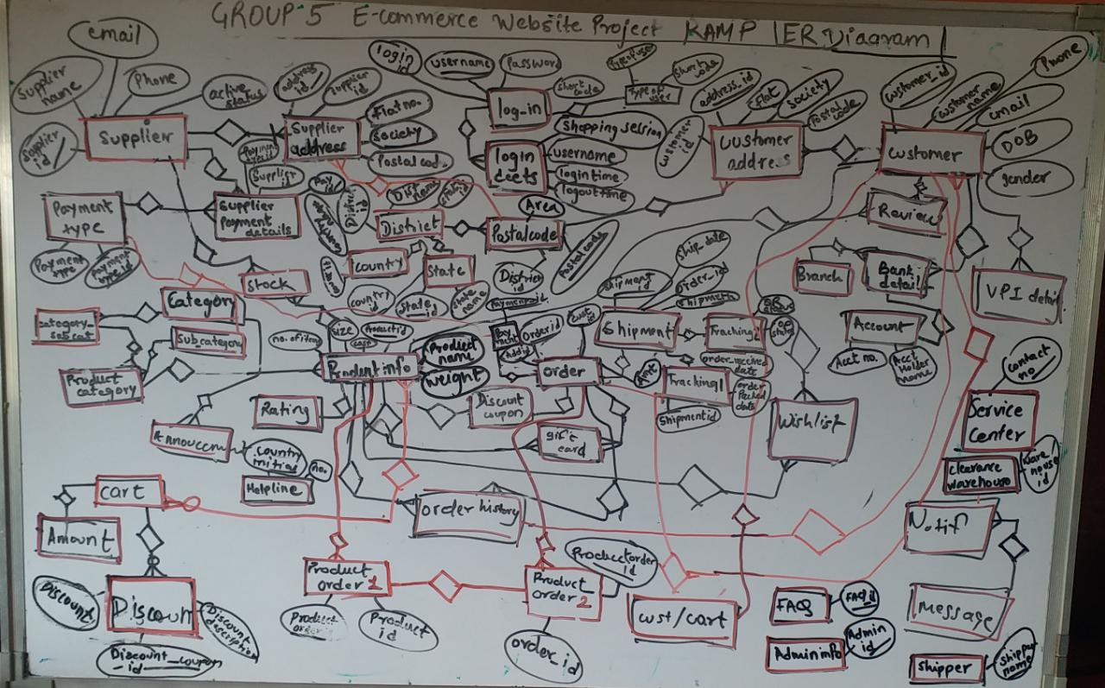
ER Diagram

Slide 4
There are total 40 tables for Database - RAMP
Tables 1
Customer
customer_id
Supplier
supplier_id
customer_name
active_status
customer_email
customer_birthdate
gender
customer_phone
supplier_name
active_status
supplier_email
supplier_phone
log_in_id
log_in
username
login_id
username
pass_word
shortcode

Slide 5
Tables 2
User_type
Type_of_User
Customer_Address
customer_add_ID
Shortcode
fk_Customer_ID
Flat_no
Society
fk_postal_code
Supplier_ Address
supplier_add_ID
Login_Details
Shopping_Session
fk_Supplier_ID
Flat_no
Society
fk_postal_code
username
Login_time
Logout_time

Slide 6
Tables 3
Country
Country_id
States
state_id
Country_name
state_name
fk_Country_Id
District
district_id
Area
postal_code
district_name
fk_state_id
Area
fk_district_id

Slide 7
Tables 4
Product_info
Product_id
Stock
ck_Supplier_ID
Product_Name
Size
wght_kg
sku
cost
Brand
Origin
LT
fk_Sub_Category_ID
ck_Product_Id
Product_stock
Sub_category
Sub_Category_ID
Category
Category_ID
Sub_Category_Name
fk_Category_ID
Category_Name

Slide 8
Tables 5
Order info
Order_id
Product_order 1
product_order_ID
fk_Customer_id
Order_date
Required_date
Shipment_ID
Amount
payment_Date
Transaction_status
fk_supplier_add_ID
Product_Id
Qty
fk_Discount_coupon_id
Total_price
Order_Id
Gift_msg
Payment
Order_ID
Payment_Type
Payment_type
Payment_id
Payment_Type_ID
Payment Date
Payment_type_ID

Slide 9
Tables 6
Supplier_PaymentType_details
Pay_ID
Shipment
Shipment_ID
fk_Supplier_ID
fk_Payment_type_ID
Ship_date
Ship_method
Expected_Delivery_date
Delivery_Status
Order received Date
Order packed Date
Customer_bankdetails
fk_customer_ID
Supplier_bankdetails
fk_supplier_ID
Account no
bank Name
IFSC code
Debit card
Credit card
Account holder name
Account no
bank Name
IFSC code
Debit card
Credit card
Account holder name

Slide 10
Tables 7
Branch_details
Branch
UPI Details
fk_Cutomer_ID
IFSC code
UPIid
Review
Product_Id
Announcement
Description
Rating
Review id
Review_DateTime
customer_ID
Review
Start date
End date
Category_ID
Description_details
Description_id

Slide 11
Tables 8
Wishlist
Product ID
Notification
customer_ID
Product Name
Like_Date
Customer Id
Msg_ID
Order_ID
Message_Rec_Date
Message_Rec_Time
notification_ID
msg
Msg_ID
Helpline
Country
Message Name
Message description
Helpline No

Slide 12
Tables 9
Cart
fk_ck_Cart_ID
Cart_customer
Cart_ID
Product_Id
Qty
cost
Discount_coupon_id
Discount
Total price
Customer_ID
Discount
Discount_coupon_id
FAQ
Faq_id
Discount
Discount_description
Question
Answer

Slide 13
Tables 10
Admin_info
Amin_id
Shipper
Shipper_name
Admin_name
admin_password
company_name
shipper_helpline
Service_ center
Location_name
Clearance_warehouse
Warehouse_id
contact_no
warehouse_name
warehouse_location

Slide 14
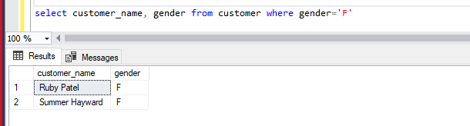
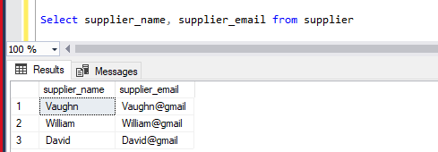
QUERIES I
1. Find all the female customers from the database
2. Find all the supplier emails from the database

Slide 15
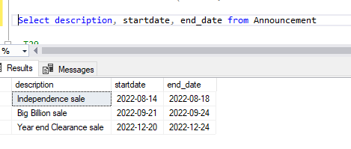
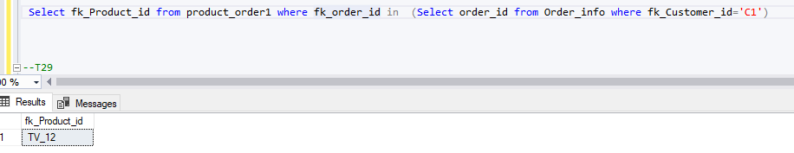
QUERIES I
3. Find all the upcoming announcements
4. Find Order created by Customer_ID C1

Slide 16
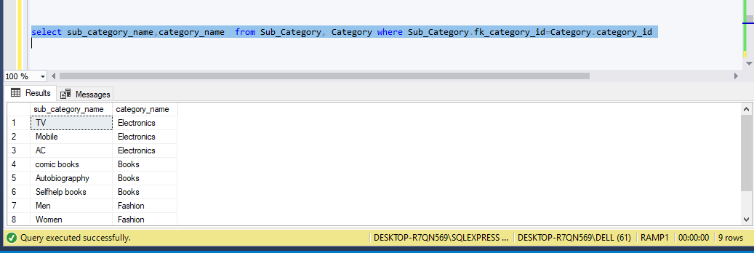
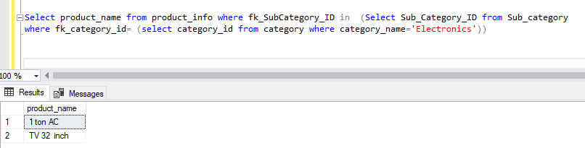
QUERIES I
5. Map all the subcategories to the Category
6. Display the name of products in category electronics

Slide 17
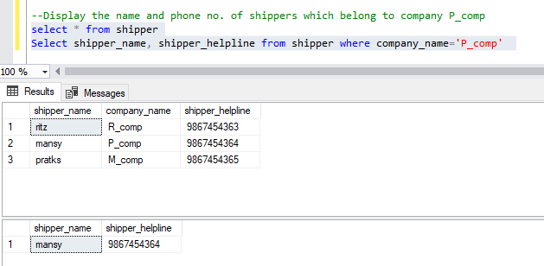
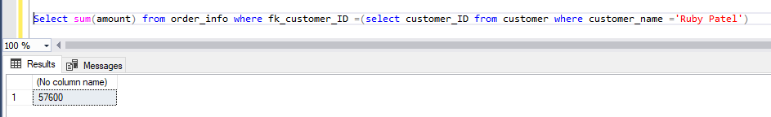
QUERIES I
7. Display the name and phone no. of shippers which belong to company p_comp
8. What is the amount total spend by Ruby Patel

Slide 18
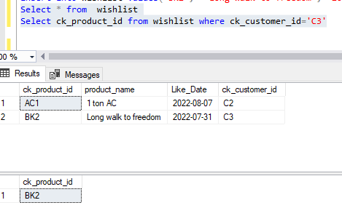
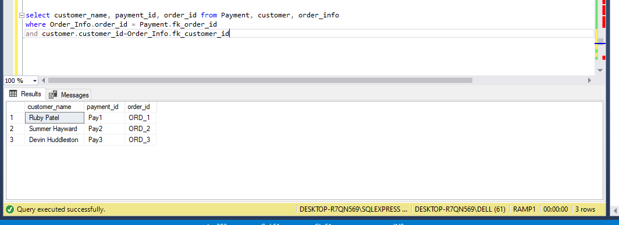
QUERIES I
9. Display products liked by customer ID C3
10. Extract the data of all customer’s payment ID for all orders

Slide 19
THANK YOU

